Slide 1

This Presentation (this slide is for instructors)
This slide and the next 2 slides are for you, the instructor.
When you are ready to begin presenting to students, begin screen sharing this presentation starting with Slide 4 (the title slide) and continue to the end.
At the "Instructor Introduction" slide (after the Agenda slide), share your background in web/software development, what motivates you to teach, and anything else you would like to share, such as your hobbies and other interests.
Slides that say "Discuss:" mean you should solicit discussion from the students, they do not mean for you to discuss the topic on your own.

Slide 2
Set-Up (for instructors)
Make sure to arrive before your students at the workshop location, or log on early if it's an online class.
For in-person classes, make sure that there are enough outlets for all students, and set up a power strip if necessary.
Log on to the Nucamp Slack. Some students may need to reach you this way!
As students arrive, have everyone log on to the Nucamp Slack also, open their project folder (NucampFolder/2-Bootstrap/nucampsite) in VS Code, and log in at the learning portal as well.
For in-person classes, ask students to join your screen sharing link (via daily.co, Zoom, Crankwheel, or other) – share the link with your students in Slack.

Slide 3
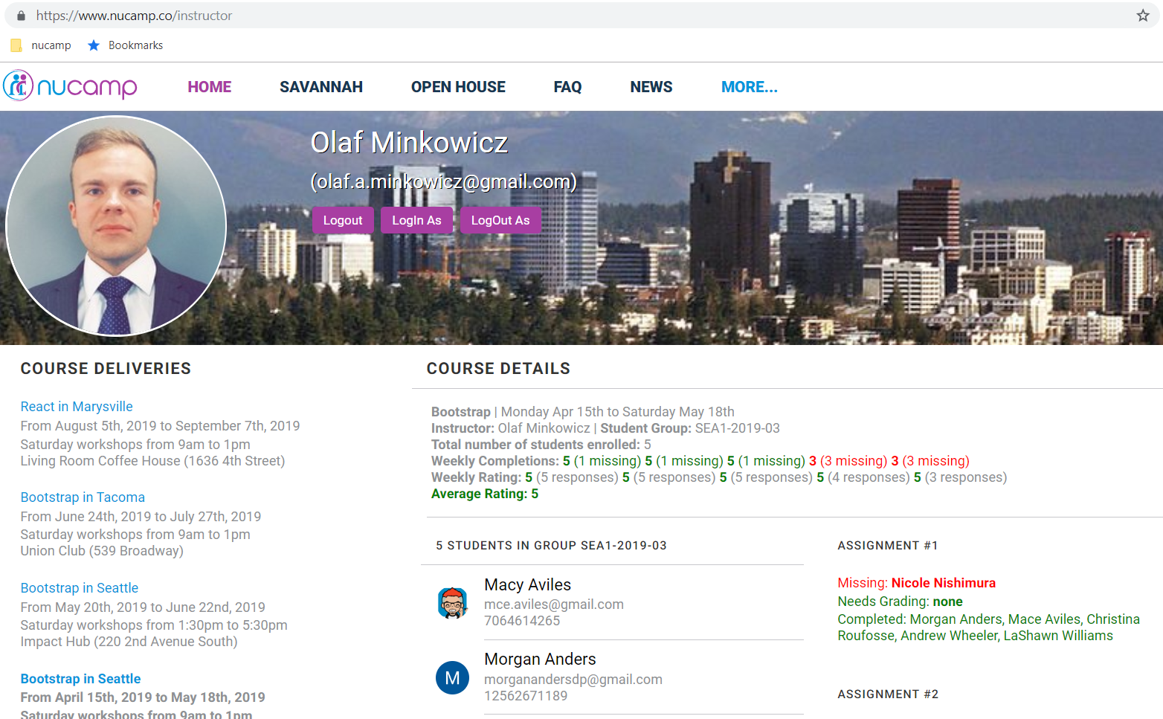
Your Students (for instructors)
Go to your instructor dashboard (https://www.nucamp.co/instructor) and check the list of students that should join your course
You should see all students in your group on learn.nucamp.co.
Call/email students who are missing from the course (not active in the learning portal/Slack) the week prior to the first workshop!

Slide 4
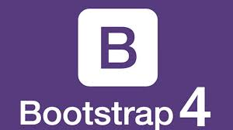

Bootstrap: Week 1
Workshop Presentation

Slide 5
Today's Agenda
Activity | Estimated Duration
Set-Up | 15 mins
Instructor & Student Introductions / Ice Breakers | 30 mins
Your Bootcamp Checklist | 30 mins
Review | 75 mins
Break | 15 mins
Workshop Assignment | 60 mins
Check-Out (Feedback & Wrap-Up) | 15 mins

Slide 6

Instructor Introduction
Hello everyone! My name is David. I am a full stack developer with 3 years of experience.
I have been working as a boot camp teacher for almost a year. This will be a my second course with Nucamp.
In my free time I love to keep up with all of Elon musk’s companies, especially SpaceX which is my favorite company. I also love to learn new new things about programming and I read a ton of books!
I am exited to get to know you all, and explore Bootstrap together!

Slide 7
Student Introductions & Ice Breakers
Take time to go around and introduce yourselves.
Share if you did or did not take the Intro course with Nucamp, and if you are enrolled in the Front End or Full Stack bootcamp.
Share one or more of the answers you gave in the Ice Breakers section from this week.
Examples:
What motivates you to take this course?
What's a fact that no one would ever guess about you?
What's been your least and most favorite jobs in the past? What's your dream job?

Slide 8
Your Learning Experience for this Bootcamp
Next week's content is unlocked at the end of the week (Fridays)
Daily tasks every day (2+ hours):
View videos and follow along with the exercises
Any Code Challenges and Quiz toward end of week
Additional exploration
Prepare for workshop assignment
Help other classmates via class forums or Slack
4-hour workshop every weekend
Read the assignment instructions,
Bring your laptop
IT WILL BE HARD
IT WILL IMPACT YOUR ROUTINE
PRINT AND BRING A COPY OF THE ASSIGNMENT INSTRUCTIONS TO THE WORKSHOP

Slide 9

The 20 minutes rule
If you ask for help too soon:
You will not learn how to tackle problems or remove obstacles, which is core to coding.
You will likely not remember the process or path that resolved the issue, which is more important than the solution.
If you ask for help too late:
You will get frustrated and tired.
You will miss an opportunity to go deeper on the same topic (time is limited).
10 minutes rule during workshops
During the week, go by the 20 minutes rule.
During workshops, go by a 10 minutes rule – try to solve the issue yourself (or with your classmate, if working together) for 10 minutes before asking your instructor for help.
20 minutes, then ask for help!

Slide 10
Bootcamp Checklist
Take about 30 minutes to go through this checklist together. Have you all:
Confirmed that you receive emails from Nucamp? | Installed VS Code on your laptop?
Installed or updated to the latest version of Chrome or Firefox? | Installed the Moodle app on your phone and connected to Nucamp with it?
Downloaded and extracted the NucampFolder to your Desktop? | Learned about using using the VS Code Integrated Terminal?
Joined the Nucamp Slack and introduced yourself? | Created an account on Codepen?
Discussed your time commitment pledge with your friends and family? | Read and agreed with the Code of Conduct?
Completed the Git lessons? | Completed the Node/NPM lessons?

Slide 11
About Your Time Commitment Pledge
Time Commitment Pledge:
14 to 20 hours of focused time every week
Weekly Commitment Pledge:
Attend every in-person workshop at the end of the week,
Spend one to three hours every day learning and performing the weekly exercises
Publish your workshop assignment on Saturday or Sunday (avoid late submissions)
Talk to your Friends and Relatives:
Have a conversation with your family, explain to them your commitment pledge and seek their support.
Similarly, reach out to your friends and seek their support.
Don't underestimate the importance of communicating your intentions to those around you!

Slide 12
Review: Bootstrap Course Overview
Bootstrap is a free and open-source front-end UI framework for developing websites, originally developed by Twitter in 2011. Bootstrap 4 is the newest version.
Bootstrap and other front end UI frameworks provide tools to build the front end without writing every component from scratch
Bootstrap is the most popular. Alternatives: MaterialUI, SemanticUI, Pure.

Slide 13
Review: Bootstrap Course Overview
This is a 5-week course. You will work on two projects throughout this course:
The in-person weekly workshop project, the "nucampsite" project.
A portfolio project of your choice, as part of a team or solo. You will build this project with Bootstrap in this course, then with React in the React course, and you will also use it in the rest of your bootcamp.

Slide 14

Review: Weekly Objectives
Week 1:
Introduction to Bootstrap and the Bootstrap Grid.
Week 2:
Learn about Bootstrap components such as navbars, buttons, forms, tables, cards, and media objects, using your course project. Begin your Portfolio Project.
Week 3:
Using your course project, learn about more Bootstrap components and how to access the functionality of Bootstrap JavaScript plugins. Begin to review JavaScript and continue working on your Portfolio Project.
Week 4:
Using your course project, learn about jQuery, CSS preprocessors, and preparing your files for deployment using NPM scripts. Continue your JavaScript review and work on your Portfolio Project.
Week 5:
Focus on completing your Portfolio Project this week, as well as learning more JavaScript in order to prepare for your transition to the React course.

Slide 15
Review: Git
Git is a free distributed version control system for tracking changes in source code during software development, created by Linus Torvalds in 2005 to help develop Linux.
You can use version control :
to revert files back to a previous state
revert the entire project back to a previous state
compare changes over time
Every time you commit (save the state of your file) in Git, it "takes a picture" of what all your files look like at that moment and stores a reference to that snapshot.
NOTE: While you should complete the initial exercises/lessons on Git for this week, Git is optional to use for the rest of your bootcamp. If on Windows, you will be using Git Bash for your command line interface.

Slide 16
Review: Node/NPM
NPM (Node Package Manager) is installed with Node.js.
It allows you to download JavaScript packages for use in your project.
When you configure your project to work with NPM, it will install a package.json file which contains settings for your project, such as its dependencies.

Slide 17
Review: VS Code Integrated Terminal
Is everyone able to access the integrated terminal and (for Windows users) set it to use bash as the default shell? (macOS users should already have bash set as the default.)
Does everyone know how to toggle the view of the terminal on and off?
Does everyone know how to open parallel shell sessions, and switch between them?
Does anyone have other questions on using it?

Slide 18
Review: Bash Commands
Basic commands you should know (same in Terminal and Git Bash):
cd to change directory: cd <dirname>
cd .. to move down from a directory
ls to list the contents of a directory
mkdir to make a new directory: mkdir <new directory name>

Slide 19
Review: Front End/Back End/Full Stack
The front end is where we deliver content to the user, typically, in a browser where they access the information. This is where we use technologies like HTML, CSS, JavaScript, and libraries/frameworks built using these technologies (Bootstrap, React, etc) to render the content for to the user.
This information delivery is supported behind the scenes by a back end, typically implemented these days using technologies like PHP, Java, ASP.NET, Ruby, Python, or NodeJS.
Full stack simply means both front and back end.

Slide 20
Review: Mobile-First, Responsive Web Design
Discuss together:
What does mobile-first design mean?
What does responsive web design mean?

Slide 21
Review: HTML Page Setup for Bootstrap
Inside the head element of your page
Bootstrap requires the use of the viewport meta tag:
<meta name="viewport" content="width=device-width, initial-scale=1" />
You will also need to link the Bootstrap CSS file:
<link rel="stylesheet" href="node_modules/bootstrap/dist/css/bootstrap.min.css" />
At the end of the body element, just before the closing </body> tag
For some of the components in Bootstrap to work, you must link the following JS files in this exact order:
<script src="node_modules/jquery/dist/jquery.slim.min.js"></script>
<script src="node_modules/popper.js/dist/umd/popper.min.js"></script>
<script src="node_modules/bootstrap/dist/js/bootstrap.min.js"></script>
Note: These linked files above can also be linked from a public file hosted at a CDN (content delivery network). This is common practice, but for the purposes of this course, we will have you download and link to the file locally.

Slide 22
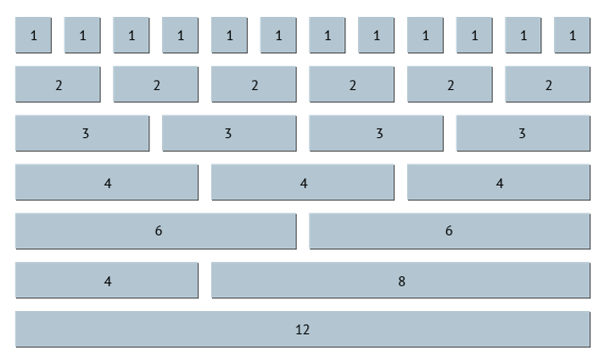
Review: The Bootstrap Grid System
Bootstrap’s grid system uses a series of containers, rows, and columns to layout and align content. It’s built with flexbox and media queries/breakpoints to be fully responsive.
Rows are wrappers for columns. In a grid layout, content must be placed within columns, and only columns may be immediate children of rows.
There are 12 maximum columns to each row.

Slide 23
Review: The Bootstrap Grid System
Column classes indicate the number of columns you’d like to use out of the possible 12 per row.
Example: If you want a column to use up 3 of the possible 12 in a row, you can use .col-4.
To make the grid responsive, apply one of the Bootstrap 4 breakpoints to the column class: small, medium, large, and extra large (sm, md, lg, xl). If you leave out the breakpoint, the column class you use will apply to all viewport sizes.
Example: <div class="col-sm-4"> will cause this div to use 4 columns for viewports that are size sm and up.
Thanks to flexbox, grid columns without a specific number will use Auto-layout to create equal width columns.
Example: Four divs with classes of .col-sm in the same row will create columns that are each 25% wide from the small breakpoint and up.
If you use grid columns without a specific number in a row with other columns that do have a specific number, they will automatically divide up whatever columns remain, equally.
Example: If you have a div with .col-sm-6 in the same row with two other divs with .col-sm, then the .col-sm divs will take up 3 columns each (because 12 minus 6, divided by two = 3).

Slide 24
Review: The Bootstrap Grid System
Discuss:
What does col-md-6 do?
What does col-12 do?
What will this row look like in a Bootstrap grid, and why?
<div class="row"> <div class="col"> 1 of 3 </div> <div class="col"> 2 of 3 </div> <div class="col"> 3 of 3 </div>
</div>

Slide 25
Review: Bootstrap Online Documentation
Bonus points* for the first person to look through the Bootstrap online documentation (at https://getbootstrap.com/docs/4.0) and say out loud the name of the class used to create a Button component with a yellow outline.
The importance of getting used to reading code documentation cannot be overstated. You're never going to memorize everything, there's too much information, and it's constantly evolving! Instead, practice finding the information when you need it.
Luckily, Bootstrap's documentation is quite thorough and well maintained.
Be forewarned. Not all documentation will be this friendly! You will often have to 'connect the dots' to make up for poorly written or missing documentation.
So when there is good documentation on a project, appreciate it and use it to the full extent.
*no actual bonus points will be awarded; good job though

Slide 26
Review: Bootstrap Order-* Classes
Bootstrap's responsive order-* classes can be used with the Bootstrap grid to change the order of columns.
You can use them with breakpoints to specify that they should only apply within certain viewport sizes, or leave them out to apply to all.
You can set the order of the column by number from 1-12. For example, to make a column appear first in a row, you can give it the class order-1.
You can also use order-*-first and order-*-last (where the * indicates an optional breakpoint size).

Slide 27
Review: Bootstrap Offset-* Classes
Use the responsive offset-* classes to force a column to move to the right in a row
You can optionally add a breakpoint, such as offset-sm-4
If you leave out the breakpoint, it will apply to all viewport sizes

Slide 28
Review: Adding Custom Styles
If adding custom styles, create an external stylesheet and link it below the link to the Bootstrap .css file.
You can write rules for existing Bootstrap classes (as you did with .jumbotron), and it will override the Bootstrap rules where there is any conflict, and keep the Bootstrap rules where there is no conflict -- as long as your custom stylesheet is linked below the Bootstrap css link.

Slide 29
Review: Bootstrap Alignment Classes
Bootstrap has many different classes to help with alignment.
In this week, you learned about align-items-center and align-self-center to help with vertical alignment.
You also learned about text-center to help with horizontal text alignment.
Discuss: How would you make text-center into a responsive class that will only apply to LG viewports and up? (Answer in next slide.)

Slide 30
Review: Bootstrap Alignment Classes
Answer: text-lg-center

Slide 31
Notes on Additional Resources
W3schools
More introductory
Structured in a linear fashion
Fewer and less verbose examples
I recommend you start here
Bootstrap documentation
More information
Structured like a technical reference manual for someone who already knows bootstrap
Not always linear
Many more, and more verbose, examples

Slide 32
Review: Week 1 Quiz
Note: If the class is running behind schedule according to the Agenda, then set aside reviewing the Quiz for now and return to it if there is time left over after all students have completed the Workshop Assignment.
It is important that students have ample time to complete the assignment during the workshop.
Review and discuss the answers to the Week 1 Quiz together.

Slide 33
Week 1 Workshop Assignment
All students should aim to finish and submit your assignment before you leave today.
Work in pairs, or groups of three. Talk to each other and figure things out together!
10-minute rule during workshops: If you and your paired partner have spent more than 10 minutes trying to figure something out, ask your instructor for help.

Slide 34
Happy learning!

